Slide 1
Pilot Plan Development
Prepared by Mission Analytics Group, Inc.
For Solano County, February 13, 2017

Slide 2
Prospective Timeline: Solano County Subsidy Pilot Plan Development
Ad Hoc Committee meetings with contractors to review Pilot components and assess commitment to participate
Pilot Plan development
(February 2018)
LPC convening (March 15, 2018)
If LPC approves plan, Pilot Plan is presented to Board of Supervisors for approval
(April 2018)
Final Pilot Plan is submitted to CA Dept of Education
(May 1, 2018)
Pilot Plan is distributed to Ad Hoc Committee
(March 1, 2018)
Pilot Plan is delivered to LPC membership for approval (March 13, 2018)
Ad Hoc Committee convenes to discuss Pilot Plan (March 6, 2018)
Notes:
State monthly income ceiling for a family of four is $3,908
Proposed pilot income ceiling for a family of four is $5,699

Slide 3
Plan Components
Initial Plan
Income Eligibility
24-Month Eligibility
Job-Search Eligibility
Family Fees
Age Eligibility for CSPP Care
Other Components
Future Revised Plan
Redistribute Unearned Funding

Slide 4
Income Eligibility (San Mateo, San Francisco, Alameda, Santa Clara)
  Increasing the income threshold for initial eligibility for subsidized care for Title 5 contractors to 85% of the state median income
24-Month Eligibility (San Mateo, San Francisco, Alameda*, Santa Clara)
  Authorizing 24-month eligibility for families entering subsidized care and families eligible based on a need other than job search
Job Search Eligibility (San Mateo, San Francisco, Alameda, Santa Clara)
  Authorizing 12-month eligibility for families certified for seeking employment as the only need
*Alameda has a variant of 24-month eligibility.
Notes:
State monthly income ceiling for a family of four is $3,908
Proposed pilot income ceiling for a family of four is $5,699

Slide 5
Family Fees (San Mateo, San Francisco, Alameda, Santa Clara)
  Establishing a family fee schedule for families with income above the state eligibility cutoff setting fees at approximately 10% of family income – Not currently relevant
Age Eligibility for CSPP Care (San Mateo, San Francisco, Alameda, Santa Clara)
  Allowing children aged 2.9 to be served in state preschool contracts to facilitate the transition to TK
Other Components (San Mateo, San Francisco, Alameda, Santa Clara)
  Authorizing 6.5 service hours for families seeking housing or seeking employment

Slide 6
Elements Not Accepted by CDE
Adjustment Factors (In Alameda, San Francisco, Not accepted for Santa Clara)
  Allowed programs to treat all contracts and age groups consistently in the use of adjustment factors
  Specifically applies to high rate districts
Sibling Preference (In Alameda, Not accepted for Santa Clara)
  Allowed contractors the option to give preference to siblings of children already enrolled in a program
Two-year contracts (Proposed by Santa Clara, Not accepted)
  Allow contractors the option of opting in for two-year contracts
Notes:
State monthly income ceiling for a family of four is $3,908
Proposed pilot income ceiling for a family of four is $5,699

Slide 7
Other Notes

Slide 8
Applying Eligibility Criteria to Voucher Programs
At County option, families receiving child care assistance through vouchers will be eligible under the same criteria as the pilot contractors.
Voucher programs include:
    CalWORKs Stage 2 (C2AP)
    CalWORKs Stage 3 (C3AP)
    Alternative Payment Program (CAPP)
Reimbursement rates for vouchers will not be affected
Notes:
Will be eligible for assistance under the same criteria, including the income threshold, the period of eligibility and the family fee schedule.

Slide 9
Pilot participation

Slide 10
Pilot participants agree to:
Accept revised contract terms reflecting the changes in eligibility
If relevant, use pilot family fee schedule
Provide data or authorize data release on earnings, enrollment and family characteristics
Assist in annual reporting
If underearning, amend contracts (temporarily) to increase pilot rates
As needed, facilitate temporary transfers
Notes:
Will be eligible for assistance under the same criteria, including the income threshold, the period of eligibility and the family fee schedule.

Slide 11
About pilot participation
Currently, a contractor can only opt in at the beginning of the pilot
A contractor can opt out at any time, but cannot return
Contractors do not need to give up funds to participate
Notes:
Will be eligible for assistance under the same criteria, including the income threshold, the period of eligibility and the family fee schedule.

Slide 12
Questions?

Slide 13
1. Income Eligibility
Counties can implement higher income eligibility thresholds for families receiving subsidized care.
New maximum can be up to the maximum allowed by the federal government = 85% of the state median income from the US Department of Health and Human Services
Creates a “pilot income eligibility range”
  Between current state maximum (70% of the 2005 state median income from the CA Department of Finance) and new threshold
Entry and exit income requirements would be identical
Notes:
State monthly income ceiling for a family of four is $3,908
Proposed pilot income ceiling for a family of four is $5,699

Slide 14
2. 24-Month Eligibility
Authorizes 24-month eligibility for families entering subsidized care and eligible on a basis of need other than job search
Re-determination of eligibility if…
    Family’s income exceeds pilot income ceiling
    Family can lower family fee or expand hours of care under different eligibility threshold

Slide 15
3. Job-Search Eligibility
Authorize 12-month eligibility for families certified with seeking employment as the only need
Parents seeking employment receive 12 month eligibility within a 24 month period

Slide 16
4. Family Fees
Counties can implement their own family fee schedule in the pilot range only.
One fee per family independent of number of children receiving subsidized care
Families pay about 10% of monthly income in child care fees
Families can deduct fees paid for children in unsubsidized care from any family fee they owe for subsidized care.

Slide 17
5. Age Eligibility for CSPP Care
  State preschool agencies that serve children for two years can consider them under the pilot income thresholds
  CSPP can enroll children under 3 (2.9 years old)
  Facilitates transition to TK

Slide 18
6. Other Components
Service Hours
  6.5 hours of services instead of 6 if a family’s only need is either seeking housing or seeking employment.

Slide 19
Revised Pilot Plan:
Redistribute Unearned Funding
Establish contract terms for the first year of the pilot to re-allocate previously unearned funding
LPC will provide recommended amounts by contract for:
    Maximum reimbursable amount (MRA)
    Child days of enrollment
    Pilot Reimbursement Rate (PRR)

Slide 20
Pilot Reimbursement Rates (PRR)
The pilot reimbursement rate can be different from the standard reimbursement rates for child care.
No new funding
PRR increases come out of reallocation of unearned MRA funds
Recommended inclusion: PRR calculation can be redone over time
PRR can be set two ways –
  To maximize the possible rate OR
  With volunteered funding only

Slide 21
Setting the PRR – Volunteered Funding
Ask all underearning contractors to redirect some or all of their underearning to the pilot
$20,000
$5,000
$400,000
$70,000…
= $7,000,000 out of $70,000,000
= 182,130 cde out of 1,821,304 in contracts

Slide 22
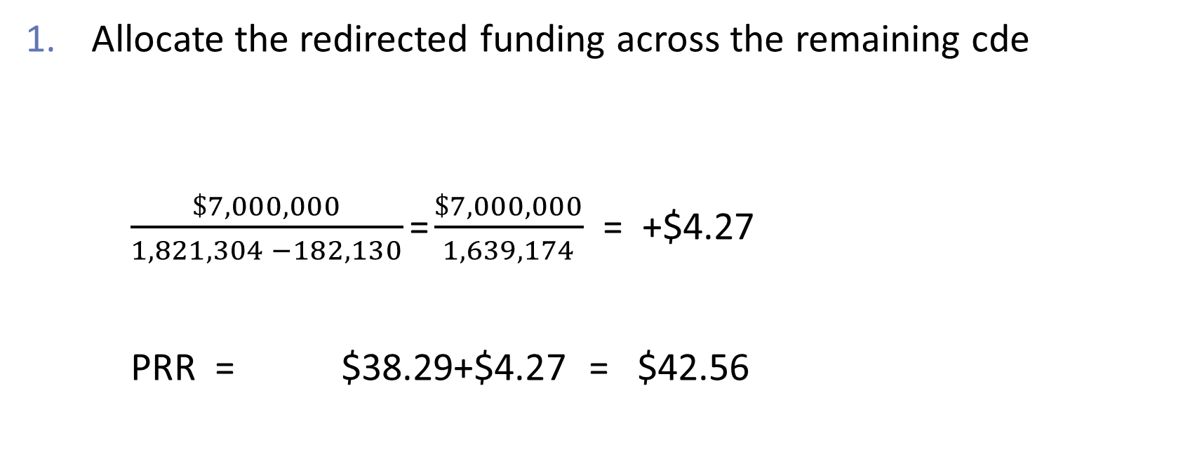
Setting the PRR – Volunteered Funding
Allocate the redirected funding across the remaining cde
$\frac{\$7,000,000}{1,821,304 −182,130}$ = $\frac{\$7,000,000}{1,639,174}$ = +$4.27
PRR = $38.29+$4.27 = $42.56

Slide 23
Setting the PRR – Volunteered Funding
Revise all contracts to set
Child days of enrollment = previous cde minus any redirected
MRA = $42.56 X cde
Plus various adjustments for districts with different rates, accounting for different contract types, etc.

Slide 24

Setting the PRR – Maximizing Approach
Consider all resources available to cover slots
All contracted MRA in CSPP & CCTR contracts $70,000,000
+
Parent fees $3,000,000
= $73,000,000

Slide 25
Setting the PRR – Maximizing Approach
2. Calculate how many child days of enrollment (cde) the funding needs to cover
Number of earned cde in base year
e.g. 1,650,000
Maybe round up a bit: 1,700,000

Slide 26
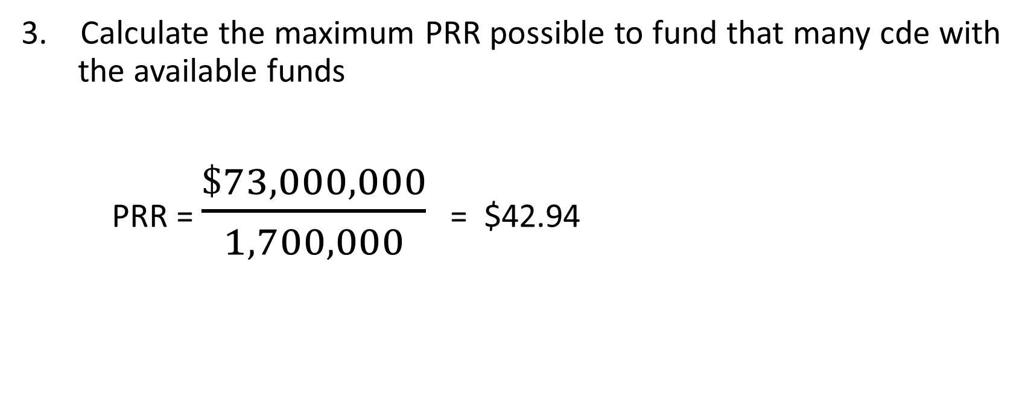
Setting the PRR – Maximizing Approach
3. Calculate the maximum PRR possible to fund that many cde with the available funds
PRR = $\frac{\$73,000,000}{1,700,000}$ = $42.94

Slide 27
Setting the PRR – Maximizing Approach
Revise all contracts to set
Child days of enrollment = previously earned minus those earned with family fees
MRA = $42.94 X cde
Plus various adjustments for districts with different rates, accounting for different contract types, etc.

Slide 28
Pilot Reimbursement Rates (PRR)
Alameda County used the “volunteered funding” approach
San Mateo, San Francisco, and Santa Clara used the “maximizing” approach
How much the two approaches differ depends on
  What share of unearned funds are volunteered
  How much money is captured in family fees (used in the maximizing but not in the volunteered approach)
  Willingness of contractors to overearn contracts in the presence of family fees

